Slide 1
Use Perturbations when Learning from Explanations
Juyeon Heo*, Vihari Piratla*, Matthew Wicker, Adrian Weller
explAIn workshop, 26 September 2023
To be presented at NeurIPS 2023

Slide 2
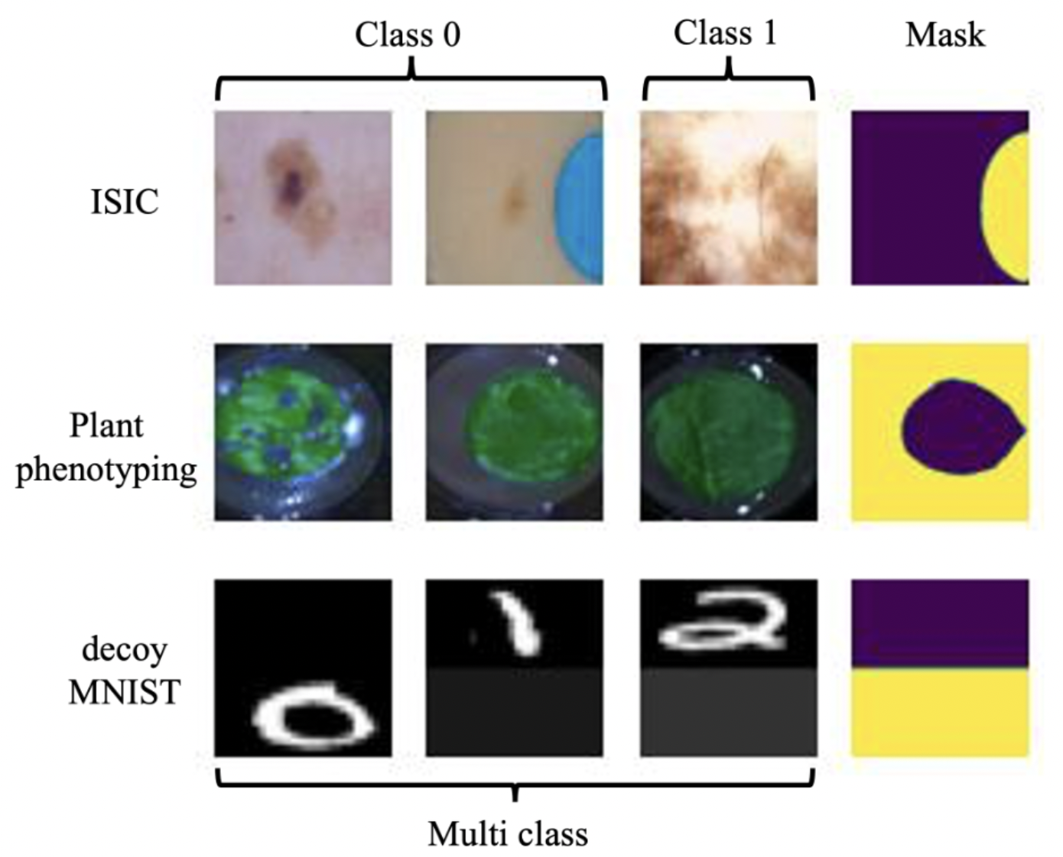
Motivation
Motivation: It is surprisingly hard to alter ML model’s prediction behavior
Need for editing is common in practice
Remove dependency on the patch for classifying the skin lesion as non-cancerous
Do not depend on the background for classifying the leaf as healthy or not

Slide 3
Motivation (continued…)
Motivation: It is surprisingly hard to alter ML model’s prediction behavior
Popular solutions:
Collect massively diverse data to negate such spurious correlation
Collect some data from each group and impose an invariance constraint across environments.
Collecting more data is very expensive (especially in healthcare)
Invariance-like methods still suffer when the minority group is not sufficiently large

Slide 4
Our problem and objective
Objective: Let user provide richer annotation and use it to learn better aligned models
Problem
Process inputs along with saliency map highlighting nuisance features
Learn a model that ignores the irrelevant regions highlighted by the explanation.

Slide 5
Machine Learning from Explanation (MLX)
Motivation: It is surprisingly hard to alter ML model’s prediction behavior
What is MLX?
To avoid shortcut learning in practical settings such as healthcare, where having diverse training data is impractical.
Regularizing DNNs to ignore features deemed irrelevant by human-provided explanations with the end goal of building models that are “right for the right reasons”
Limitation of previous MLX methods
Their quality of supervision is determined by the nature of the interpretation approaches
Constraints using local explanations need not apply globally. This is problematic as in order for the proposed MLX loss to be globally effective at reducing shortcut learning, heavy parameter regularization is required.

Slide 6
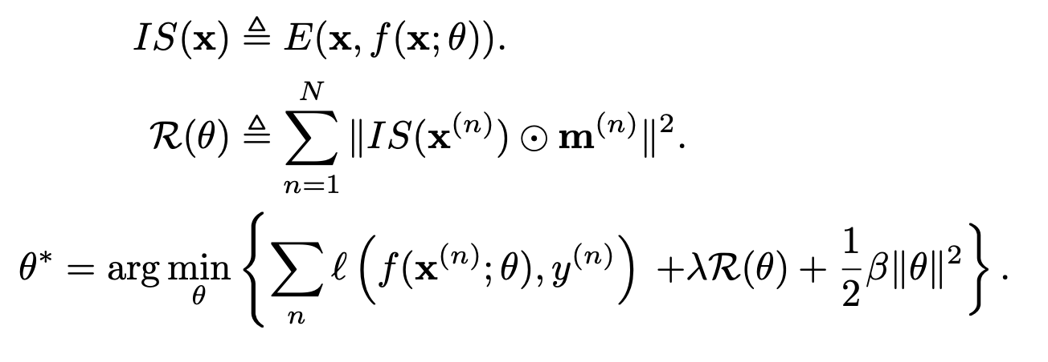
Background
An explanation algorithm (E) to assign importance scores to input features: IS(x), which is then regularized with an R(θ) term such that irrelevant features are not regarded as important.
Regularization-based

Slide 7
Background
Robustness to perturbation drawn from human specification
Our methodology is built on the interpretation of the provided mask as a specification of a low-dimensional manifold from which input perturbations are drawn.
Robustness-based

Slide 8
Our Study
We did a systematic study of
Robustness-based
Regularization-based and
Their combination
for the problem of effective learning from human-specified explanations.

Slide 9
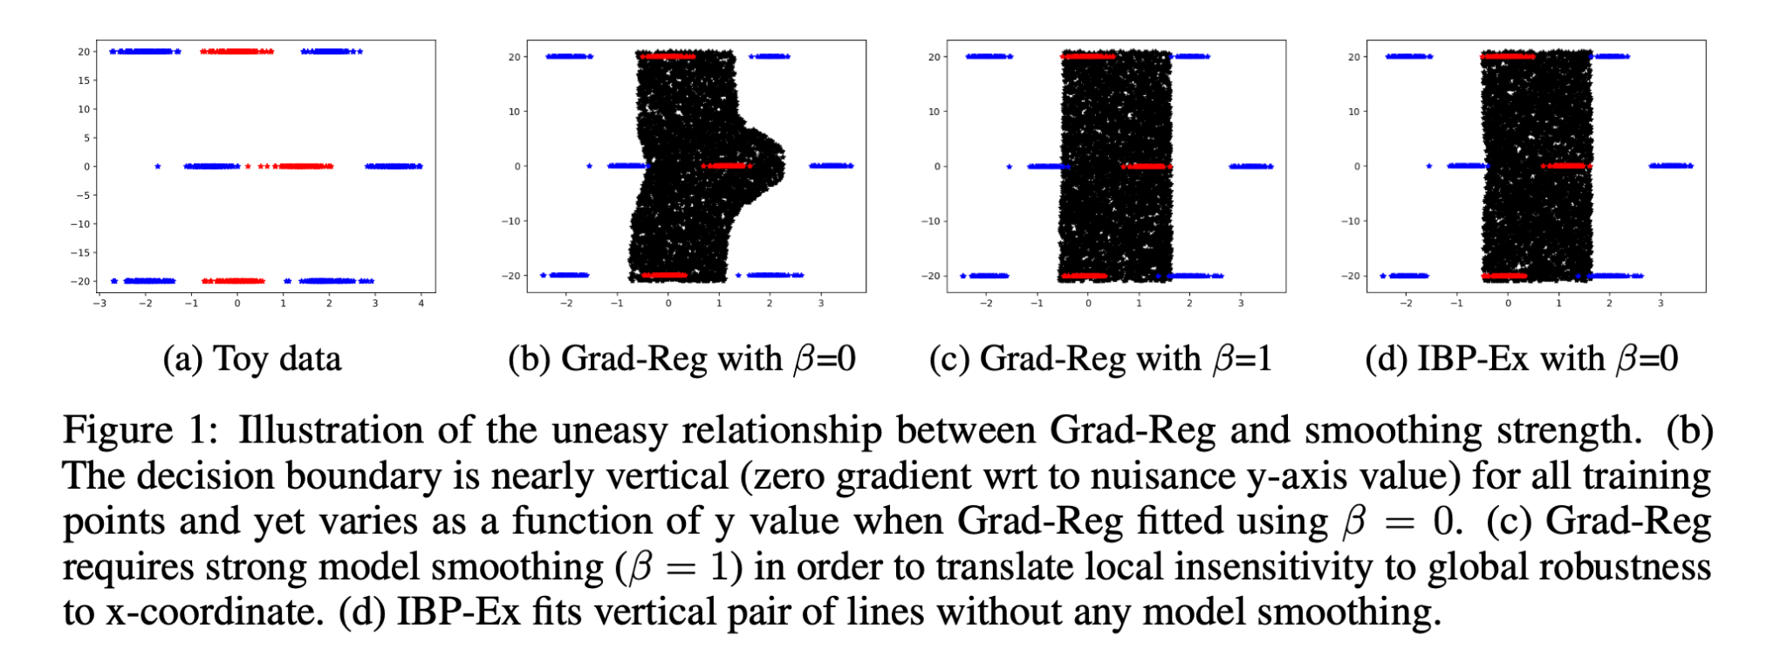
Our findings
Regularization-based although popular are not effective

Slide 10
Analysis for why robustness-based better than regularization-based

Slide 11
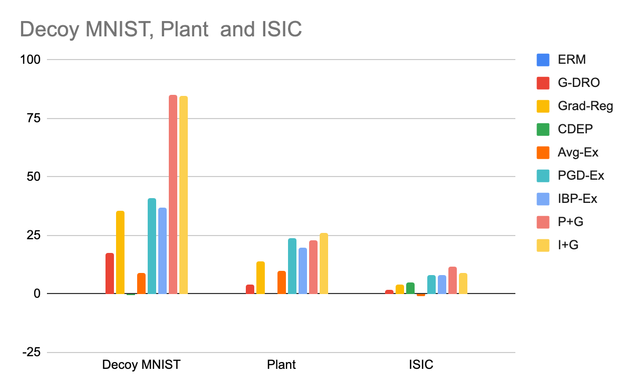
Results
Regularization-based
Robustness-based
Regularization + Robustness-based
Robustness-based methods are better
Robustness + regularization-based are consistently better on all the datasets

Slide 12
Takeaways
We presented intuition and theoretical analysis for why robustness-based methods are not suited for supervising with human explanations.
We studied robustness-based method for supervising with human-explanations, which is surprisingly not studied before.
Our systematic study and analysis showed advantage in combining robustness and regularization-based methods for effective supervision.
Future
Reducing human effort.
Assistance in providing human explanations
Partial specifications
Automated discovery of regions

Slide 13
Thank you

